Slide 1

OCN 479-001
3D Design

Slide 2
Today’s plan
Rest of semester plan
Interactive lecture
Build sensors!

Slide 3

Rest of semester plan/check-in

Slide 4
Check in/plan
How are we feeling with writing, compiling, and flashing code? Common challenges?
How are we feeling with wiring/breadboarding/soldering?
6 more classes (including today!).
Final class dedicated to final presentations, so 5 classes for development
Ideally we’ll deploy in penultimate class, so 4 classes for development
Your first deployment might not work, so 3 classes for development and deployment test ;)
Progress—everyone is doing well, but going to be extremely tight. Make sure if you are not your group’s coding leader that you find other work to stay busy. No one should be sitting on their hands at this point in the semester; plenty of jobs for all.
Final reports need some data—doesn’t have to be final, successful instrument, but has to have something. Talk with your team about how you will ensure inclusion of data in your final presentation and continuity report.

Slide 5
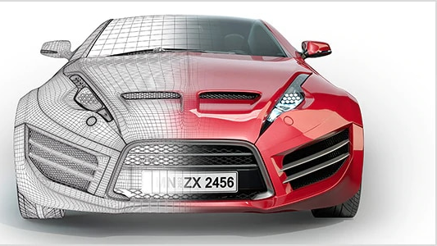
Today’s topic
3D Design

Slide 6
3D Design
Many options: some free, some extremely expensive
Some good for hobby design, some for professional
Some meant for engineering, some for art/professional design

Slide 7
3D Design Process
Measure
Measure what you have. What are you building around? E.g., sensor components, off-the-shelf PVC tubes, etc.
Sketch 2D
Sketch out what you think you want, starting with 2D
Sketch 3D
Sketch out 3D
Consider
Consider how it will be made:
3D printer?
CNC mill?
Manual lathe?
Hacksaw & hot glue?

Slide 8
3D Design Process
Measure
Measure what you have. What are you building around? E.g., sensor components, off-the-shelf PVC tubes, etc.
Sketch 2D
Sketch out what you think you want, starting with 2D
Sketch 3D
Sketch out 3D
Consider
Consider how it will be made:
3D printer?
CNC mill?
Manual lathe?
Hacksaw & hot glue?
Even better—many manufacturers supply part drawings in datasheets, or even supply CAD models for you to use!

Slide 9
CAD (Computer-Aided Design) should be preceded by PAD (Pencil-Aided Design)
Let’s draw an end cap for a single housing with a few individual sensors that need to contact the water (i.e., protrude through the end cap)
Known requirements:
Must have outer diameter that nearly matches inner diameter of housing it is going into (leave some wiggle room AKA tolerance)
Must have thru holes with diameters that match diameters of sensors that will protrude (again, with some tolerance)
Should have features to help put it into housing, e.g., softened edges that will slide in more easily
Can’t have features smaller than smallest printable/machinable feature
Can’t have footprint larger than working area of printer/machine

Slide 10


Slide 11
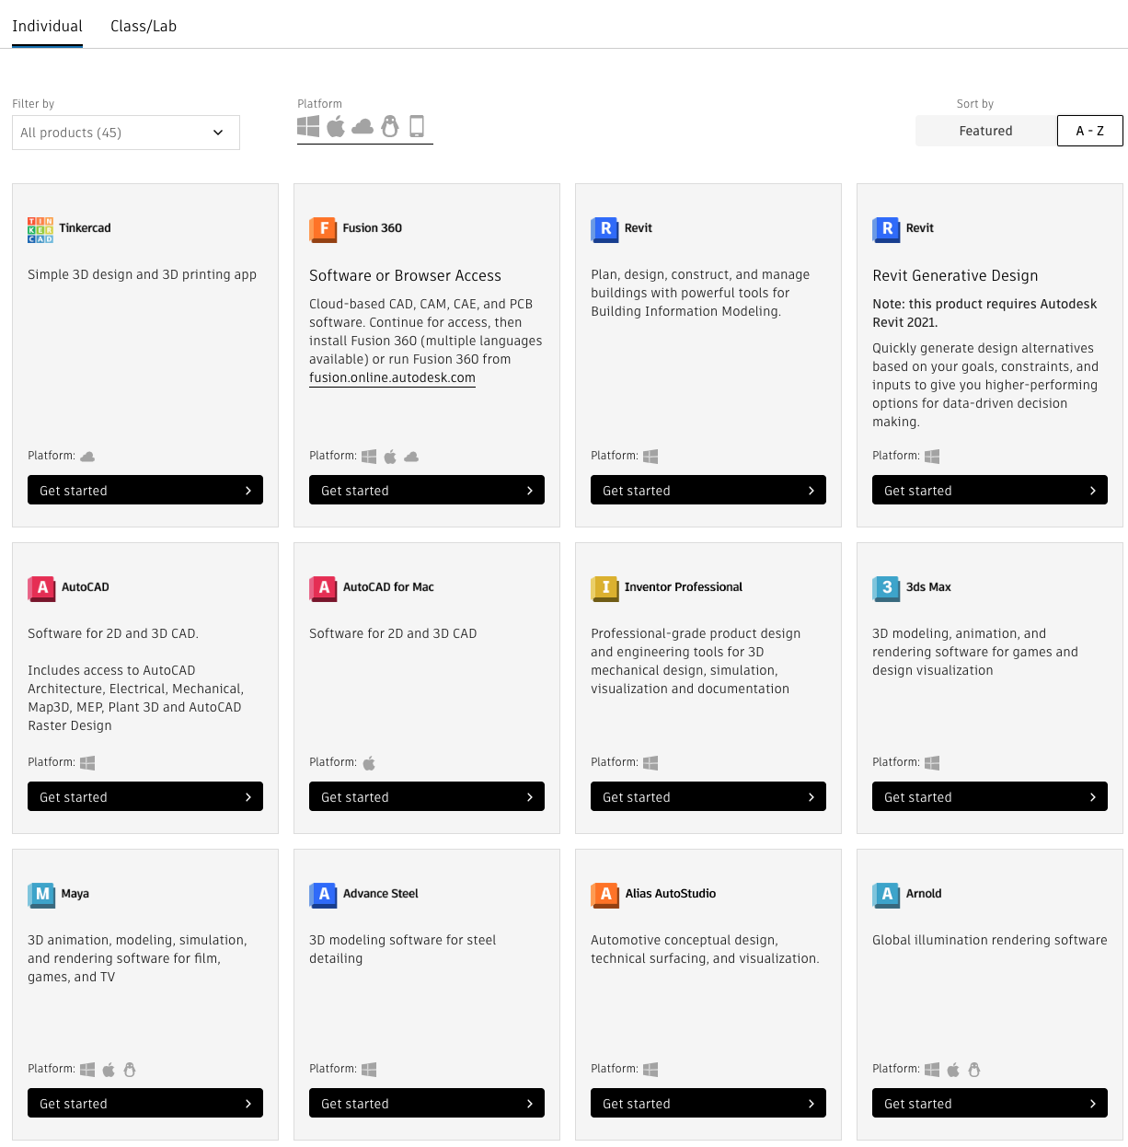

Slide 12
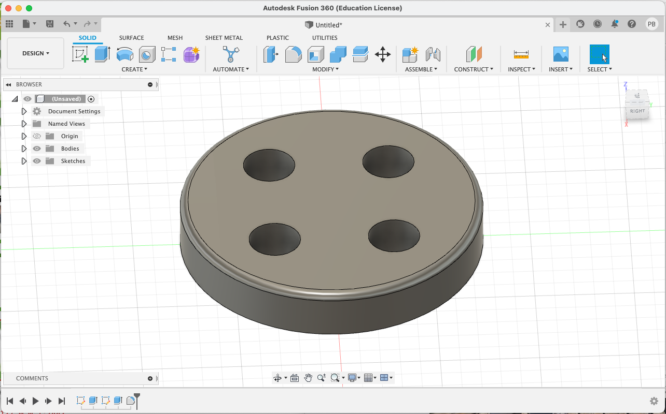
Fusion 360

Slide 13
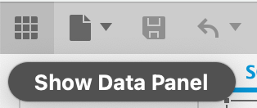
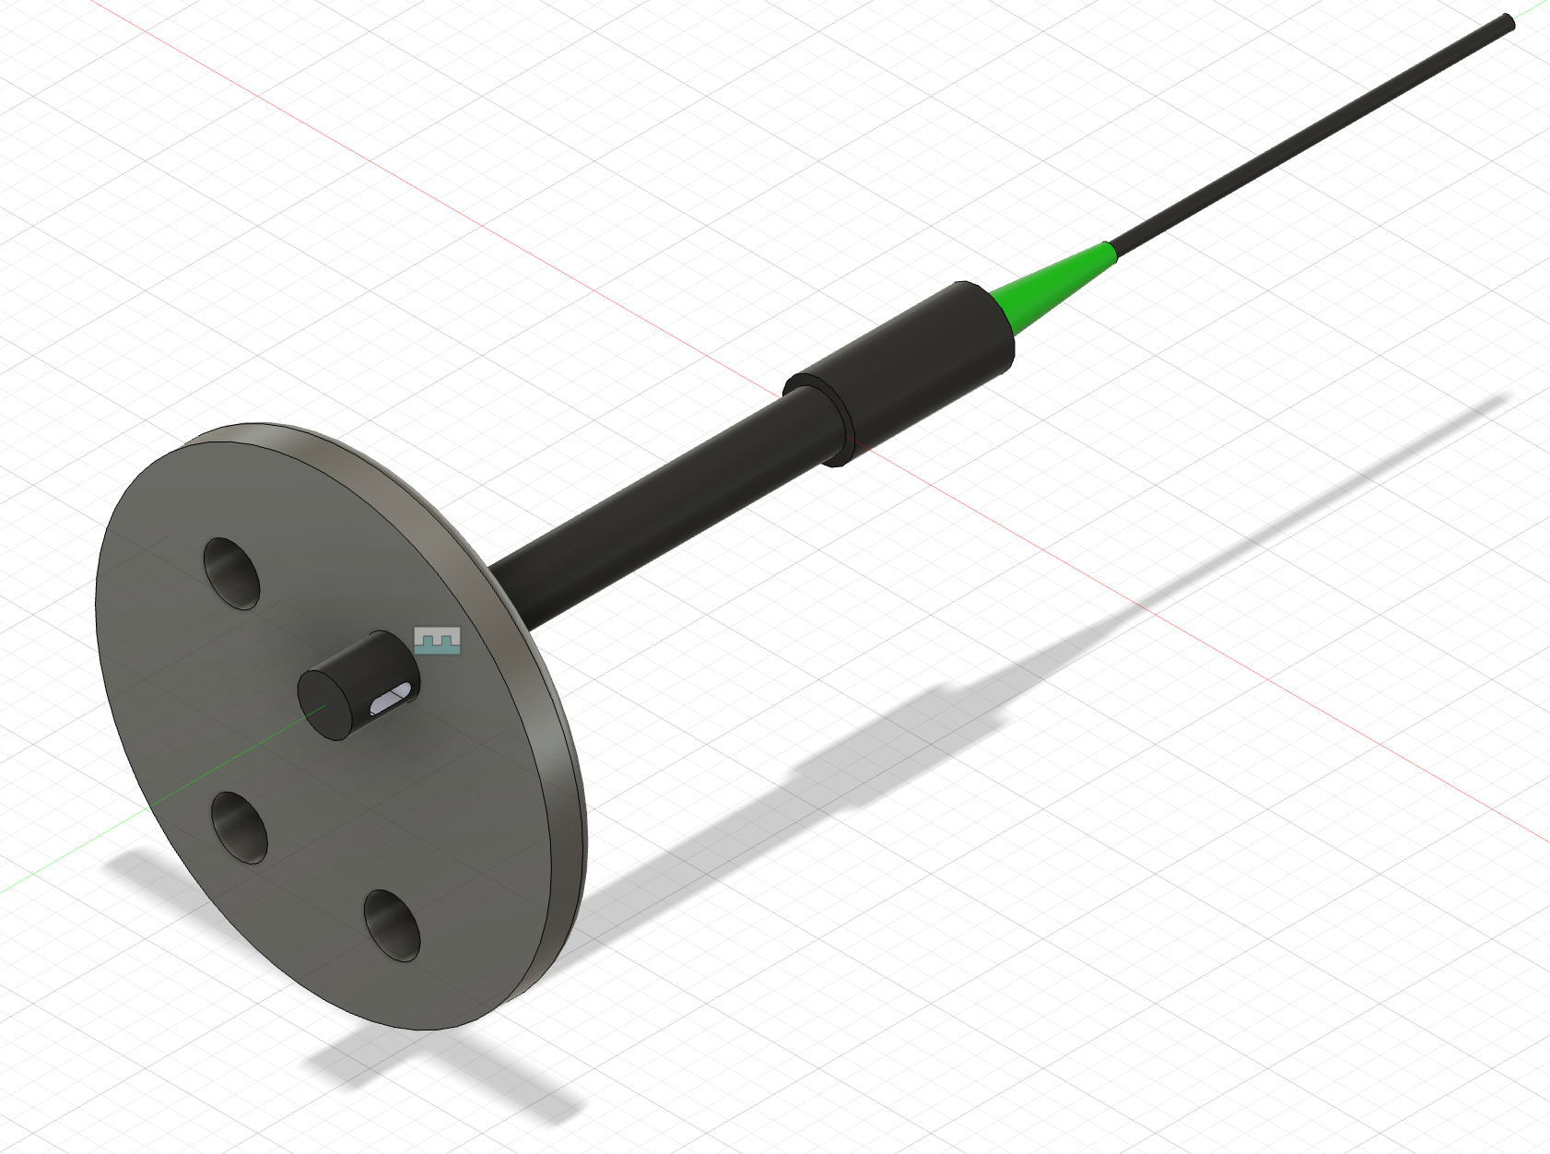
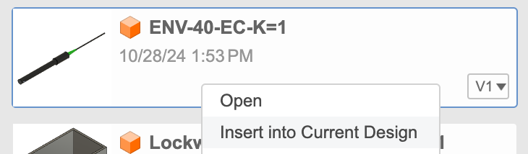
Fusion 360 Assembly
Open Panel on top left of Fusion
Download .STEP file of Atlas K1 Conductivity probe from Atlas website
Open .STEP file in Fusion, save to current cloud project
Create new design file in Fusion
Right click on assembly parts in Panel and select “Insert into Current Design”
Select “Joint” option under “Assemble toolbar and define relationships

Slide 14
What to do with 2D or 3D models
Subtractive manufacturing:
Start with piece of stock material (solid brick/sheet/rod of material)
Drill, cut, lathe, sand, file, etc.
Additive manufacturing:
3D printing: start with nothing but an empty panel
Add filament or cure resin

Slide 15
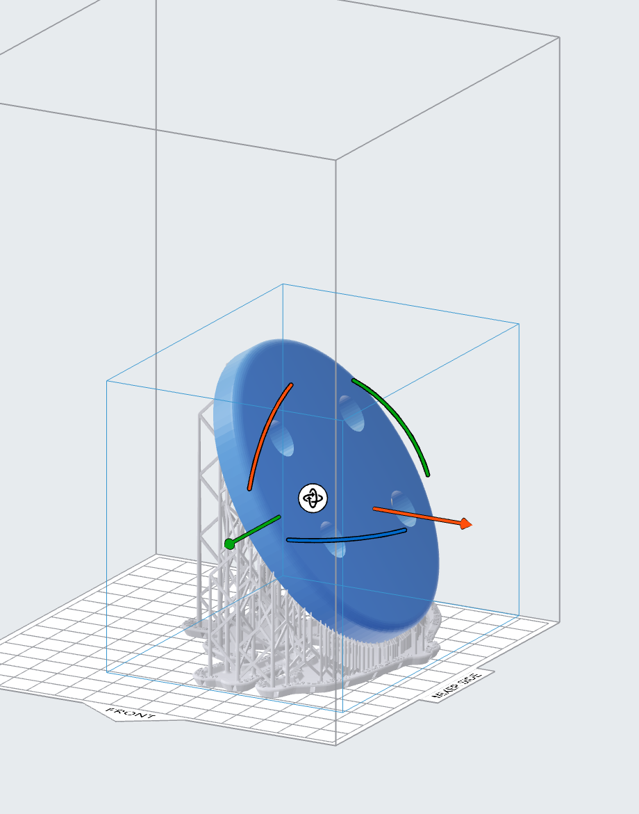
Export as .stl, open in FormLabs’ PreForm software

